Slide 1

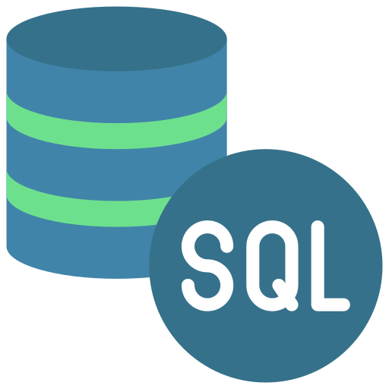


Slide 2
Introduction to SQL
SQL Databases are frequently utilized as Relational Databases for the deployment of Cloud applications. They offer a variety of tools for accessing, adding, managing, and processing data in addition to high-performance analytics. It is a database system that is simple to use, has reliable classification functions, and provides straightforward dependability.

Slide 3
History of SQL
In 1970, "A Relational Model of Data for Large Shared Data Banks" was released by eminent computer scientist "E.F. Codd".
The E.F. Codd study provided the information that IBM researchers Raymond Boyce and Donald Chamberlin used to develop the SEQUEL (Structured English Query Language). In 1970, SQL was created at IBM Corporation's San Jose Research Laboratory.

Slide 4
Features of SQL
01
A SQL operation can easily be implemented using SQL procedural language statements and features, which allow you to integrate control-flow logic into conventional static and dynamic SQL statements.
02
A SQL function is usually more reliable than an equivalent external function.
03
Provide a powerful but straightforward model for handling conditions and errors

Slide 5
Introduction to MongoDB
It is a NoSQL document database that is open-source. For the creation and maintenance of applications, it is frequently used in conjunction with Amazon Web Services, Azure, and other data sources.
In simple terms, MongoDB is a document-oriented database. The development and support of this open-source product is handled by 10gen.

Slide 6


History of MongoDB
The company began developing Mongodb in 2007 as it worked on a platform as a service that was comparable to Microsoft Azure.
10gen founded Mongodb, which is now owned by Mongodb Inc., a company with its headquarters in New York. Initially, the platform was intended to be a PAAS (Platform as a Service). Mongodb Inc. released it as an open-source database server toward the end of 2009.

Slide 7
Features of Mongodb
01
There are multiple search options in MongoDB, including field, range, and regular expression categories.
02
It provides tools for map reduction and aggregation.
03
The code is written in JavaScript instead of Procedures

Slide 8
SQL vs. MongoDB: key differences
SQL database | MongoDB
It is a relational database | It is a non-relational database
Supports SQL queries | Supports JSON queries
Scalable vertically – increasing RAM | Horizontal scalability – more servers can be added
Contains predefined schema | It contains a dynamic schema
Trigger support | It does not support triggers
Foreign key support | It does not support foreign keys

Slide 9
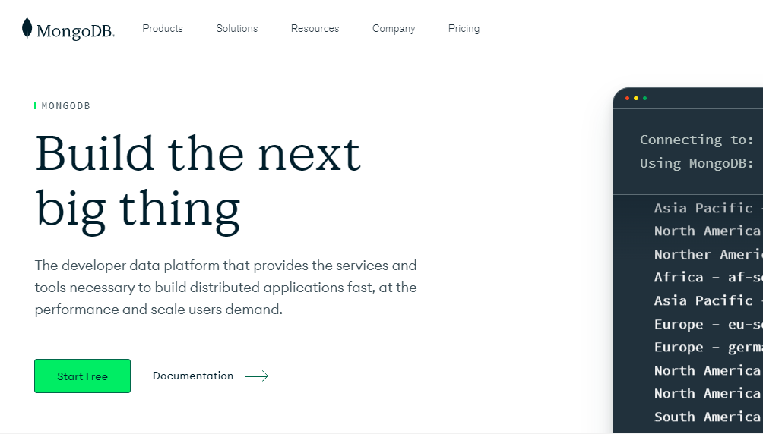
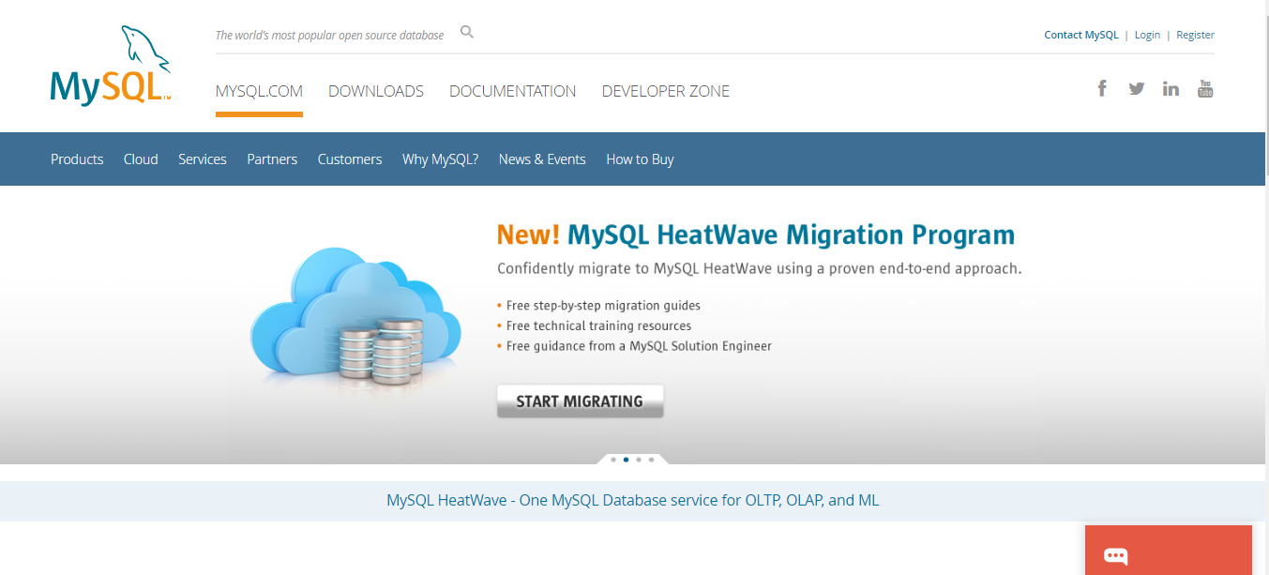
Thank you!
SQL Database vs MongoDB

